Slide 1
🔍 AtliQ Mart Promotion Performance Analysis

Slide 2
Project Overview
Objective
Analyze campaign effectiveness to guide future promotions
Scope
Store-level performance
Promotion-type effectiveness
Product & category insights
Executive ad-hoc analysis

Slide 3
Store Performance Analysis

Slide 4
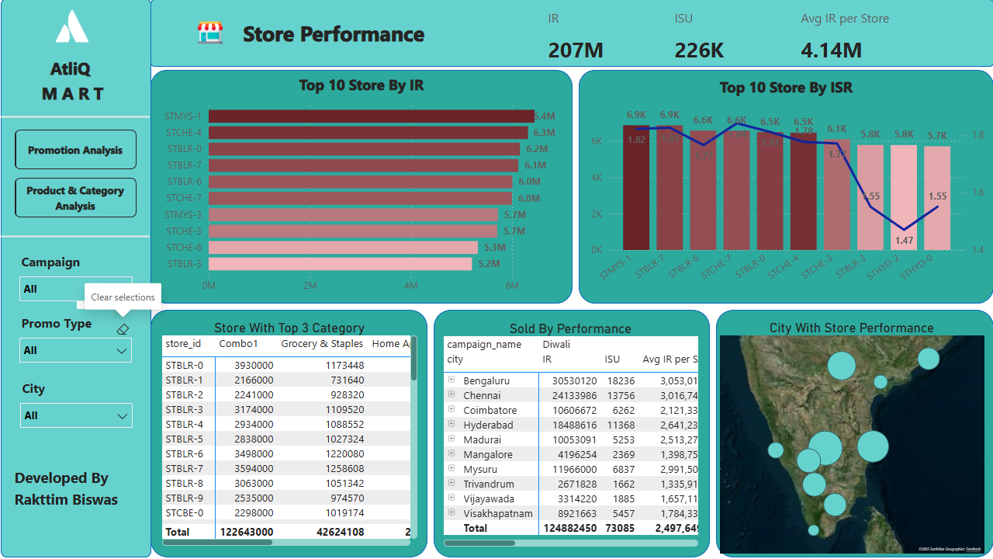

Slide 5
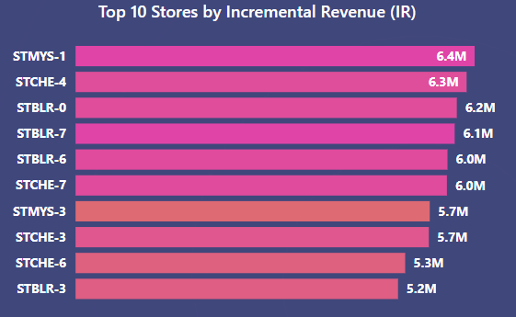
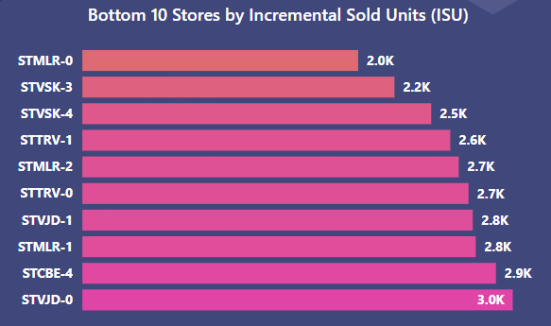
Which are the top 10 stores in terms of Incremental Revenue (IR) generated from the promotions?
Which are the bottom 10 stores when it comes to Incremental Sold Units (ISU)during the promotional period?
Highest IR approx ₹6.4M at STMYS-1
Lowest ISU around 2.0K units at STMLR-0
Second highest IR approx ₹6.3M at STMYS-4
Second lowest ISU around 2.2K units at STMLR-3

Slide 6
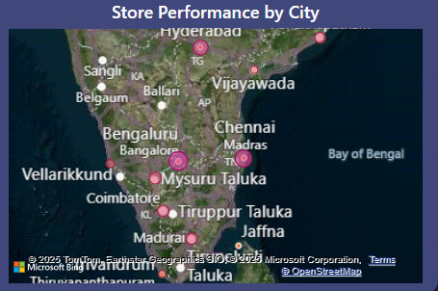
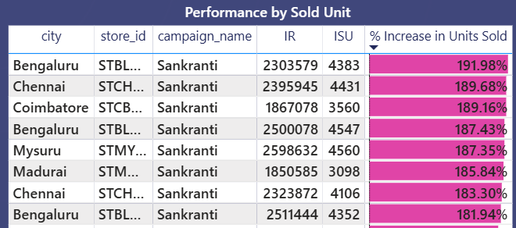
How does the performance of stores vary by city? Are there any common characteristics among the top-performing stores that could be leveraged across other stores?
Bengaluru, Chennai, Mysuru led sales during Sankranti

Slide 7
Promotion Type Analysis

Slide 8
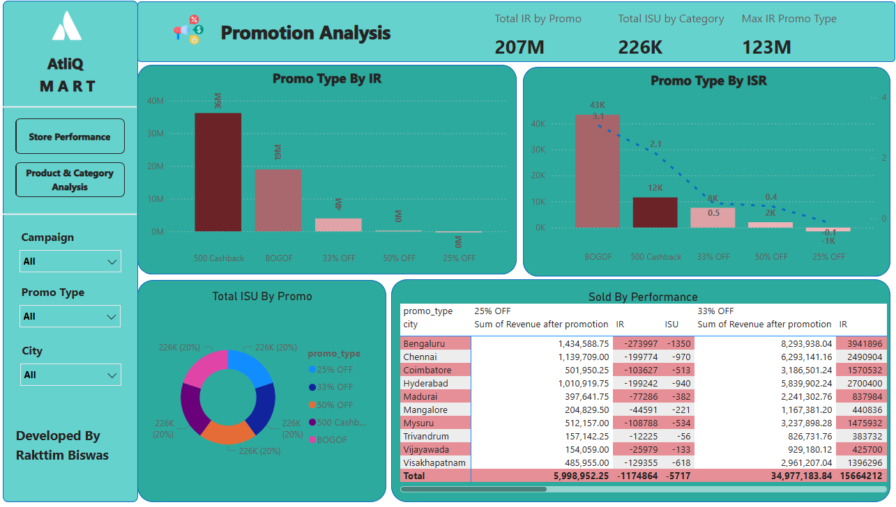

Slide 9
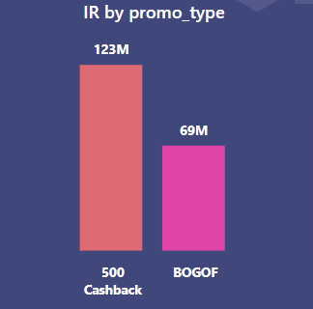
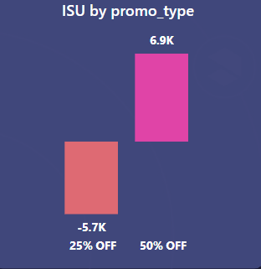
What are the top 2 promotion types that resulted in the highest Incremental Revenue?
What are the bottom 2 promotion types in terms of their impact on Incremental Sold Units?
₹500 Cashback: ₹103M
25% OFF: Negative ISU -5717
BOGOF: ₹69M
50% OFF: ISU 6931

Slide 10
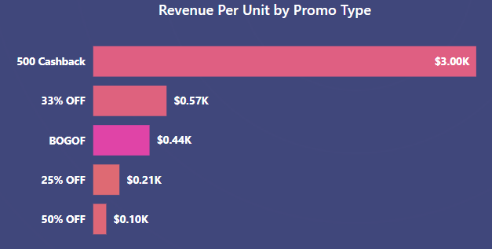
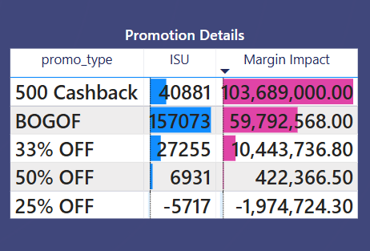
Is there a significant difference in the performance of discount-based promotions versus BOGOF (Buy One Get One Free) or cashback promotions?
Which promotions strike the best balance between Incremental Sold Units and maintaining healthy margins?
Value-based promotions outperform percent discounts
Cashback offers best IR-ISU balance

Slide 11
Product and Category Analysis

Slide 12
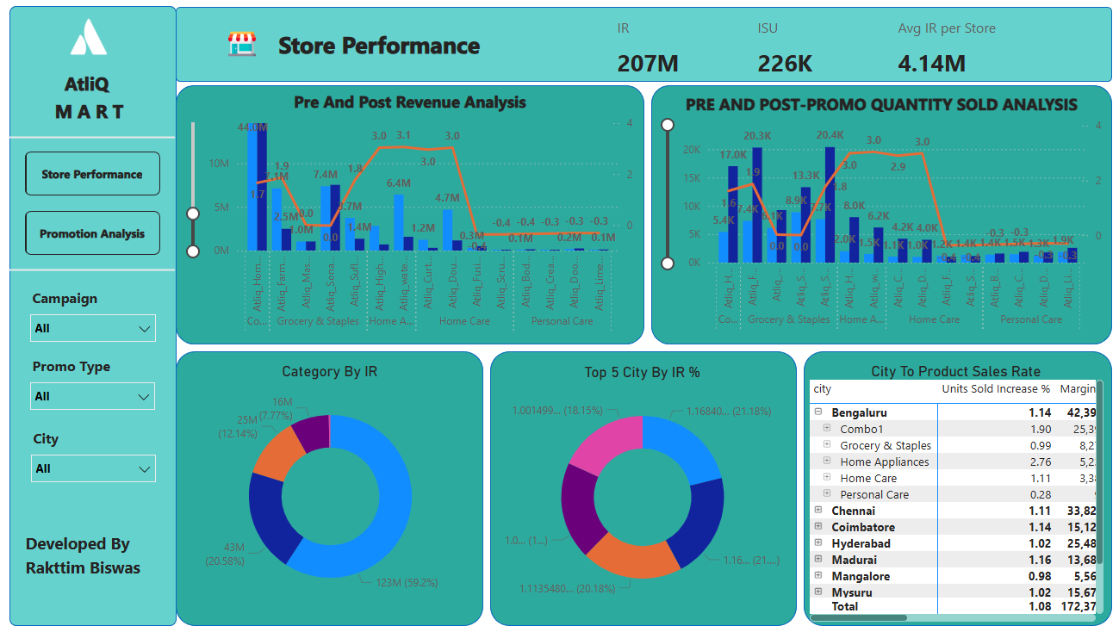

Slide 13
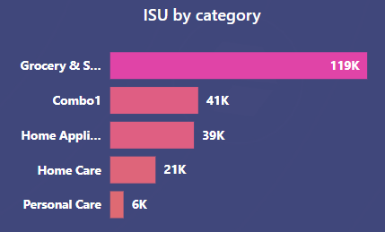
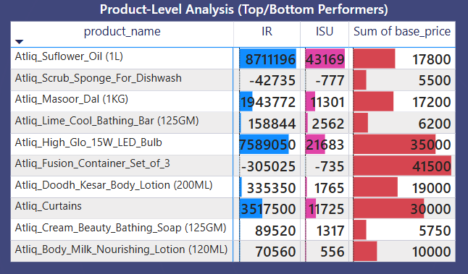
Which product categories saw the most significant lift in sales from the promotions?
Are there specific products that respond exceptionally well or poorly to promotions?
Grocery & Staples ~119K units
Combo Packs ~41K units
Atliq Sunflower Oil (1L): 43K units
Atliq LED Bulb: ₹7.6M incremental revenue

Slide 14
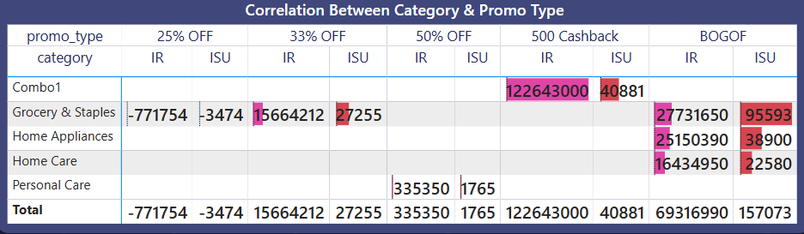
What is the correlation between product category and promotion typeeffectiveness?
Atliq Scrub Sponge: Negative IR & ISU
Fusion Container Set: Low sales, high price

Slide 15
Executive Summary
What Worked
What Didn't
₹500 Cashback & BOGOF led returns
High % discounts hurt margins
Combo packs, grocery staples performed well
Some SKUs underperformed despite promos
Strong city performance: Bengaluru, Chennai

Slide 16
Business Request

Slide 17
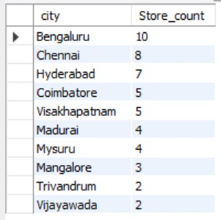
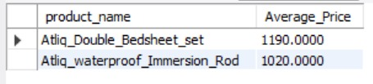
Provide a list of products with a base price greater than 500 and that are featured in promo type of 'BOGOF' (Buy One Get One Free). This information will help us identify high-value products that are currently being heavily discounted, which can be useful for evaluating our pricing and promotion strategies.
Generate a report that provides an overview of the number of stores in each city. The results will be sorted in descending order of store counts, allowing us to identify the cities with the highest store presence. The report includes two essential fields: city and store count, which will assist in optimizing our retail operations.

Slide 18
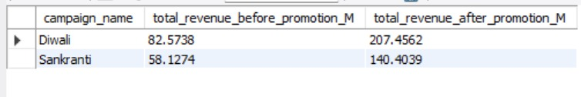
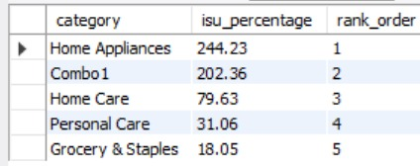
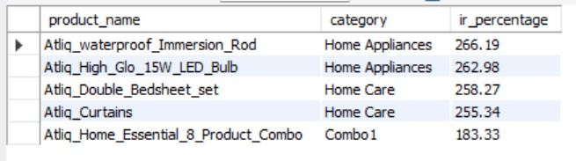
Generate a report that displays each campaign along with the total revenue generated before and after the campaign? The report includes three key fields: campaign_name, total_revenue(before_promotion), total_revenue(after_promotion). This report should help in evaluating the financial impact of our promotional campaigns. (Display the values in millions)
Produce a report that calculates the Incremental Sold Quantity (ISU%) for each category during the Diwali campaign. Additionally, provide rankings for the categories based on their ISU%. The report will include three key fields: category, isu%, and rank order. This information will assist in assessing the category-wise success and impact of the Diwali campaign on incremental sales.

Slide 19
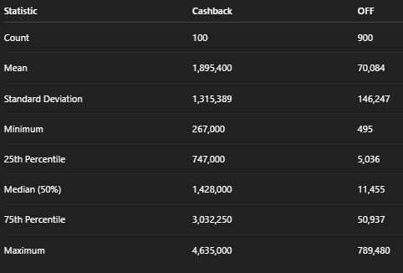
Cashback promotions have significantly higher mean and median revenue.
The spread (standard deviation) is much larger in the Cashback group, indicating more variability
The minimum revenue under Cashback is higher than even the median of OFF promos, highlighting its significant impact

Slide 20
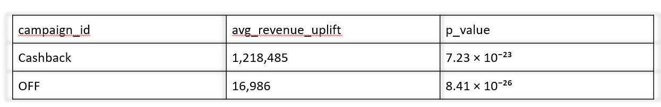
Summary:
Both promo campaigns led to a statistically significant increase in revenue.
The Cashback campaign showed a much larger average uplift in revenue compared to the OFF campaign.
The tiny p-values indicate the chance that these observed uplifts are due to random chance is practically zero.
So, the Cashback promo is more effective at increasing revenue than the OFF promo based on this analysis.

Slide 21
Thank You

